Slide 1

deepfake detector bot – Social Disinformation
Aswin Shriram Thiagarajan
Advised by
Dr. Saiph Savage
Claudia Flores-Saviaga

Slide 2
What is Social Disinformation?
“Disinformation is a subset of propaganda and is false information that is spread deliberately to deceive. It is also known as black propaganda. It is sometimes confused with misinformation, which is false information but is not deliberate.” – Wikipedia.
Mostly use social media to manipulate people on a large scale
Feeding biased or partial information
Why it can be a big deal?
Can breed hatred among the people, instill fear and chaos in the society
Global repercussions

Slide 3

Deepfakes
Generative ML algorithm
Usually a fabricated data (image/video) by swapping/replacing faces of humans in the data
Analogous to CGI in movies
Easy to create synthetic data
Can be used with malicious intent

Slide 4
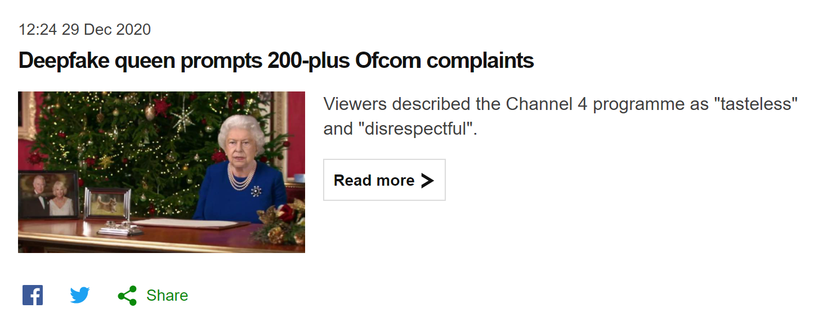
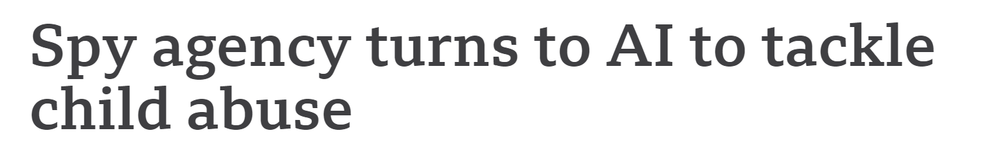
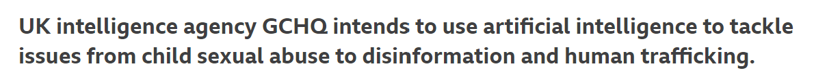
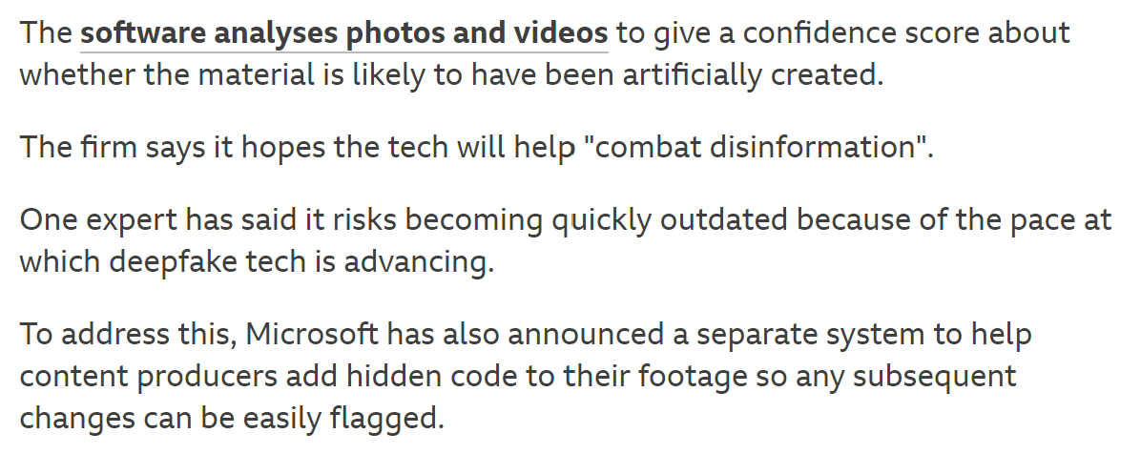
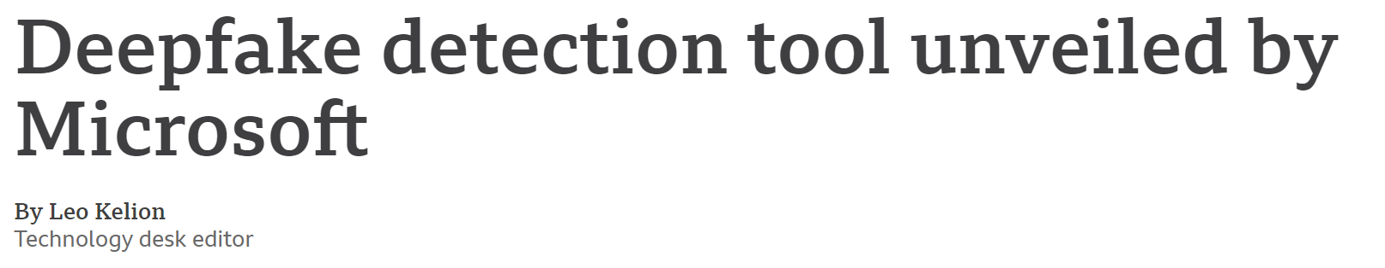
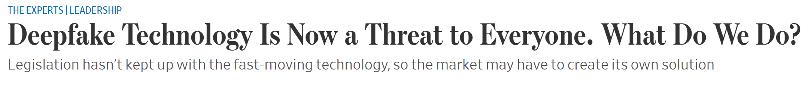
News on Deepfakes
News Source: https://www.bbc.com/news/technology

Slide 5
Facebook’s DFDC
Deepfake Detection Challenge Results: An open initiative to advance AI (facebook.com)
Deepfake Detection Challenge | Kaggle
An initiative to automate detection and prevent propagation of falsified information
The problem is still not completely solved
The out of sample performance of top model is around 60%
How can we improve?
Can we bring humans in the loop? Is it scalable?

Slide 6
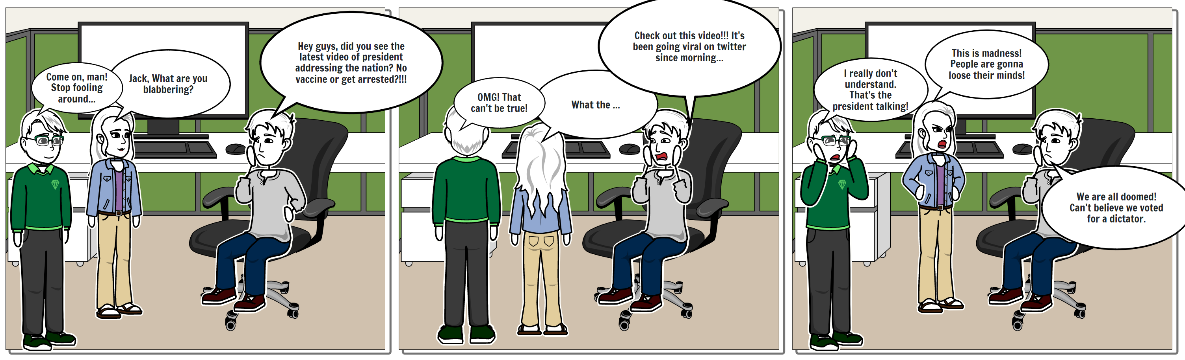
Design Motivation: Storyboard

Slide 7
Design Motivation – User Journey
Phases | Encountering Information | Researching on information | Sharing Information | Impact of Information
Activity | Users coming across an information. | Reading more about it. | Forwarding the information on social media platforms. | Taking actions in response to the message in the information.
Touchpoint | Seeing a video of a national leader. | Searching for more similar videos and reading comments of other people. | Forwarding the video to friends and family. | Convey what they feel in a tweet/status update (happy or angry or etc.).
Experience | A fabricated video is going viral online. | The video is real enough to make the users trust and forget its credibility. | Instant sharing to other people in contact. | Can have nationwide/global impact unless fact checked.
Opportunity | Implement methods to scan and identify potential false/fake information. | Implement fact-checking protocols and systems. | Restrict potential disinformed data from being shared across. | Faster counter measures and detailed explanations to bring down global hysteria.

Slide 8
Design Motivation
Pain Points:
Need for large-scale, low latency systems in place to curb or reduce social media disinformation
Current digital forensics methods are expensive and cannot match the rate of information spread
Why AI?
Fast, large-scale deployment and can be automated
Where can we include AI?
Identification of Fake information
Querying (text/image) for similar information to track down source material
Challenges of AI?
Possibility of misclassification or higher false negatives (pred. fake as real)
Lack of explainability or interpretability
Where can we include humans?
Reviewing the AI output and provide feedback/corrections
Manual investigation of origin of true/source material

Slide 9
Design Motivation – Mental Model
Feature: Deepfake Detector Twitter Bot
What does it do?
It examines the user provided video and replies to the tweet whether the video is fake or not
Describe the user group
Twitter users of all demography, nationality, ethnicity, culture, profession, etc.
What do users use it for?
To fact-check the information they came across in social media platforms
According to this group of users, how does the feature work?
AI performs investigation, analyze the content and generates diagnostic output
According to this group of users, when might the feature work well?
When the video contains clear faces, brighter lighting and obvious facial distortions
According to this group of users, when might the feature work poorly?
When the video is very realistic, when the person in the frame is not talking and poor lighting

Slide 10
Designing for different stakes
Feature: Deepfake Detector Twitter Bot
What does it do?
It examines the user provided video and replies to the tweet whether the video is fake or not
What is a way this feature could fail with low/no consequences?
When the prediction by the AI model has low confidence on classification and the human response backs up with explanation
What is a way this feature could fail with large negative consequences?
When the prediction by the AI model has high confidence on mis-classification and the human response suggests the opposite (False Negatives on critical information)
What is a way this feature could fail with catastrophic consequences?
When the prediction by the AI model has high confidence on mis-classification and the human workers also couldn’t provide correct details (False positives and negatives on critical information)

Slide 11
Designing for different stakes (cntd….)
What technical (AI/ML/etc.) methods exist to mitigate these failures/recover from them?
Continuously adapting the model to look for context in which the deep fakes are built
Retrain with new datasets and new paradigms
Reinforcement and Causal Learning can help reuse the features from older models
What human (personal/social/etc.) methods exist to mitigate these failures/recover from them?
Collaboration with digital forensics experts and develop newer methodologies
Hierarchical review system with increasing level of expertise, when unsure of the output on that level
What alternative tasks might AI seek to do instead which have lower/different risks of failure?
Instead of suggesting confidence-based classifications, can focus on search and retrieval of similar content using unsupervised ML methods
Focus on explainability of the solution (XAI), such that it becomes easier to debug, reason and analyze

Slide 12
Design Motivation – Heuristic Approach
Feature: Deepfake Detector Twitter Bot
How would you improve how the system presents the visibility of the feature (keep the user informed about how the feature is changing)?
Will provide updates as automated tweets to all the followers and also update the links to documentation in the profile page
How would you ensure that the feature matches the users’ jargon?
The users will only have very few options to interact now, tagging the bot and providing a video with a text that should contain any of the following: ‘detect AI’ or ‘detect human’
Since it is straight forward, there is no additional requirement for matching jargons
How would you ensure that the user can easily leave an unwanted action (how do you ensure user control and freedom)?
Here the feature has very limited options, so there is no room for unwanted action
One possibility would be, users providing redundant video/data which increases traffic in our system
To mitigate we can maintain a database, log the data and its results

Slide 13
Heuristic Approach (cntd….)
How would you ensure that the feature follows industry consistency and standards?
This mostly must deal with social media regulations which also influences the design strategy on how to restrict the flow of fake data
Having in place, multiple human stakeholders (experts) for increased reliability
How would you ensure your feature has error-prevention?
The AI prediction, will still undergo quick review with human expert team before responding to the user
Focus more on False negatives and train model to handle them
How would you ensure your feature is prioritizing recognition over recall?
The bot can be made to listen for latest tweets and process them automatically without the user having to ask, and retrieve the results quickly when user asks them

Slide 14
Heuristic Approach (cntd….)
How would you ensure your feature provides flexibility and efficiency?
Ensuring flexibility – Since it is available in twitter, users can mention the bot, direct message it, and even share the results
Ensuring efficiency – The system consists of both AI and Humans; it will provide a quicker (AI is fast in inferencing) and robust solution (humans can reason better).
How would you ensure your feature has minimalistic design?
Keeping the design loop simple and only focused on relevant features
Reusing the pipeline wherever necessary, simple explainable interface (tweet response)
How would you ensure your feature facilitates recovering from errors?
All the information related to prediction, feedback are logged for future debugging and recovery
What type of documentation related to your feature would you have?
As mentioned earlier, directions for user to interact with the bot like keywords to be present, ways to interact, feature scope, etc.

Slide 15
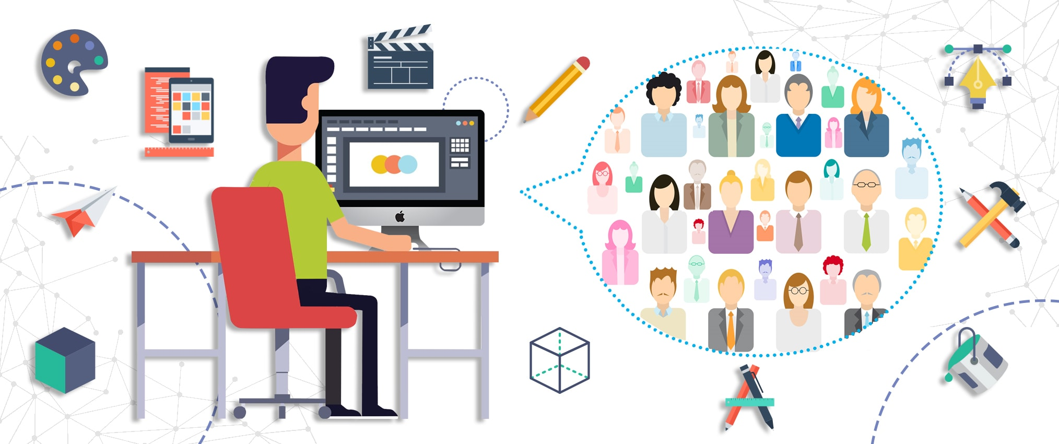
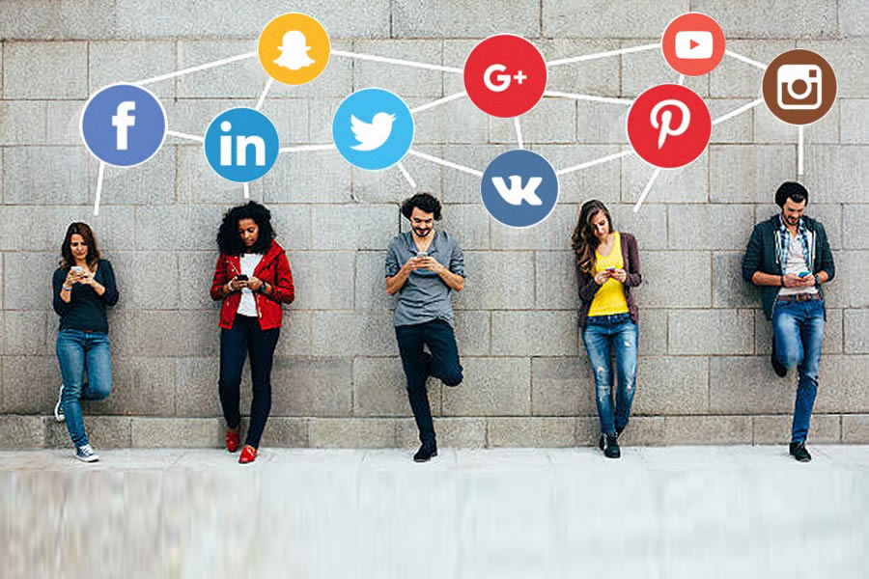
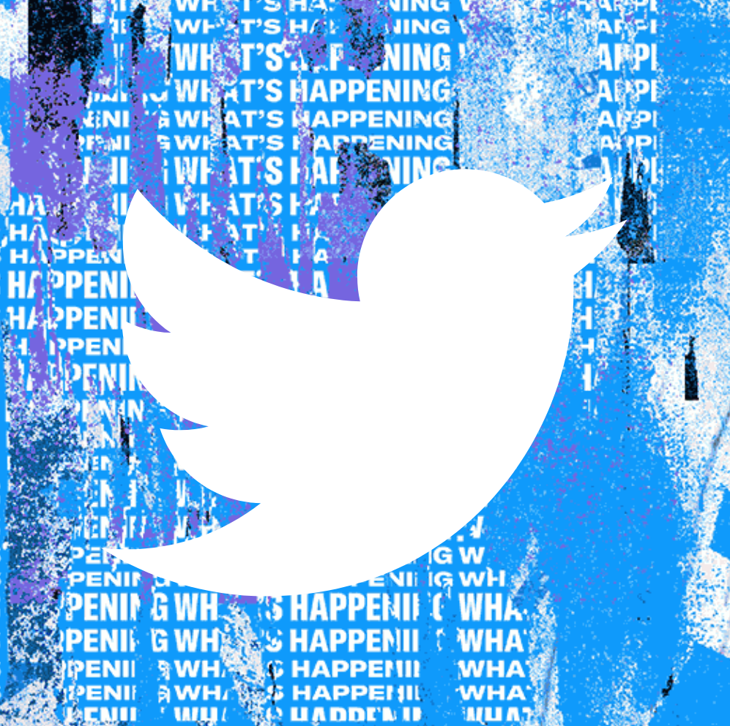


Design Architecture
Crowdsourcing (Humans)
Post tweet
Detailed response
Saving results/feedback
Tagging bot and tweeting
Keyword: ‘Humans’
Keyword: ‘detect’
Code base
+
Tweepy API
+
Toloka API
Second Stage review and feedback
Notification
Database
Get Response
Keyword: ‘AI’
User/Front End
Instant Response
Saving results/logs
API creator & connector
Tweet/mention listener
Video/media data processor
Model Inferencing module
Update response module
Model Retrain/Tuning
AI model
Code base
Developer/Back End

Slide 16
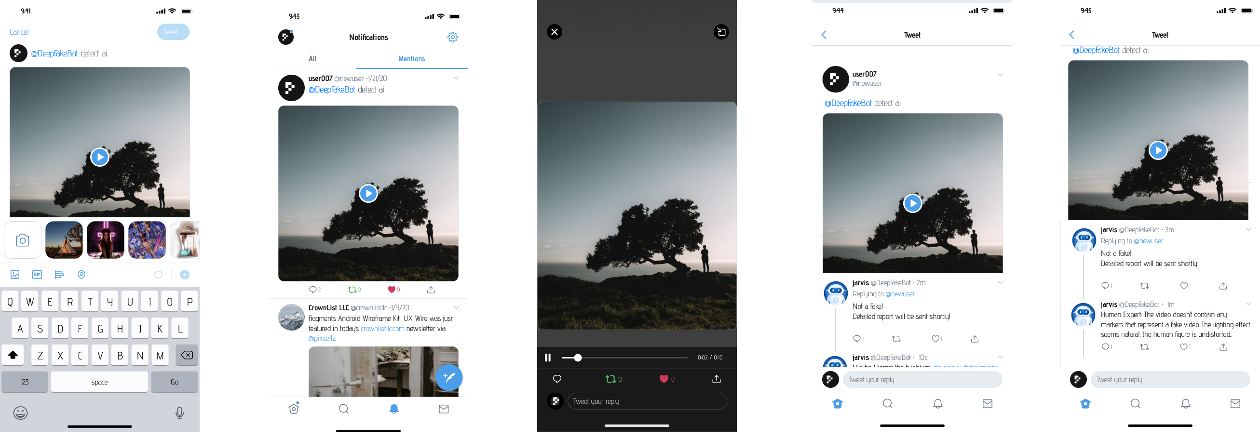
Design Motivation – Detection using AI

Slide 17
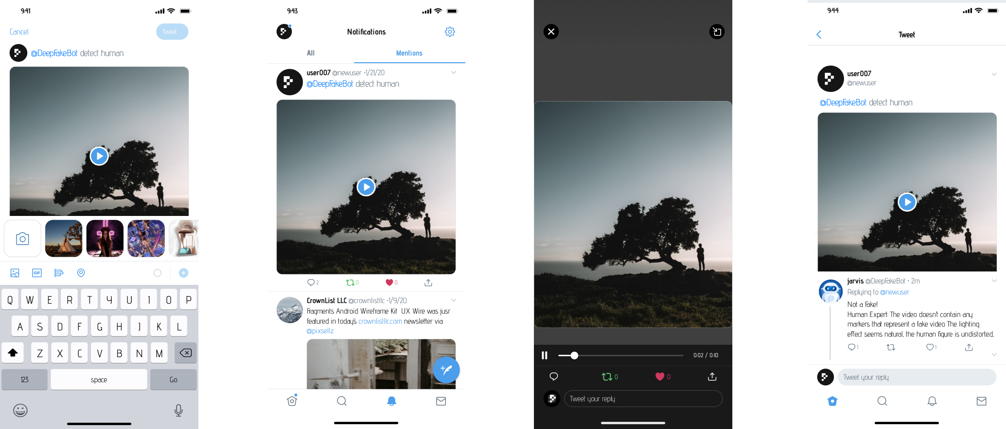
Design Motivation – Detection using CS

Slide 18
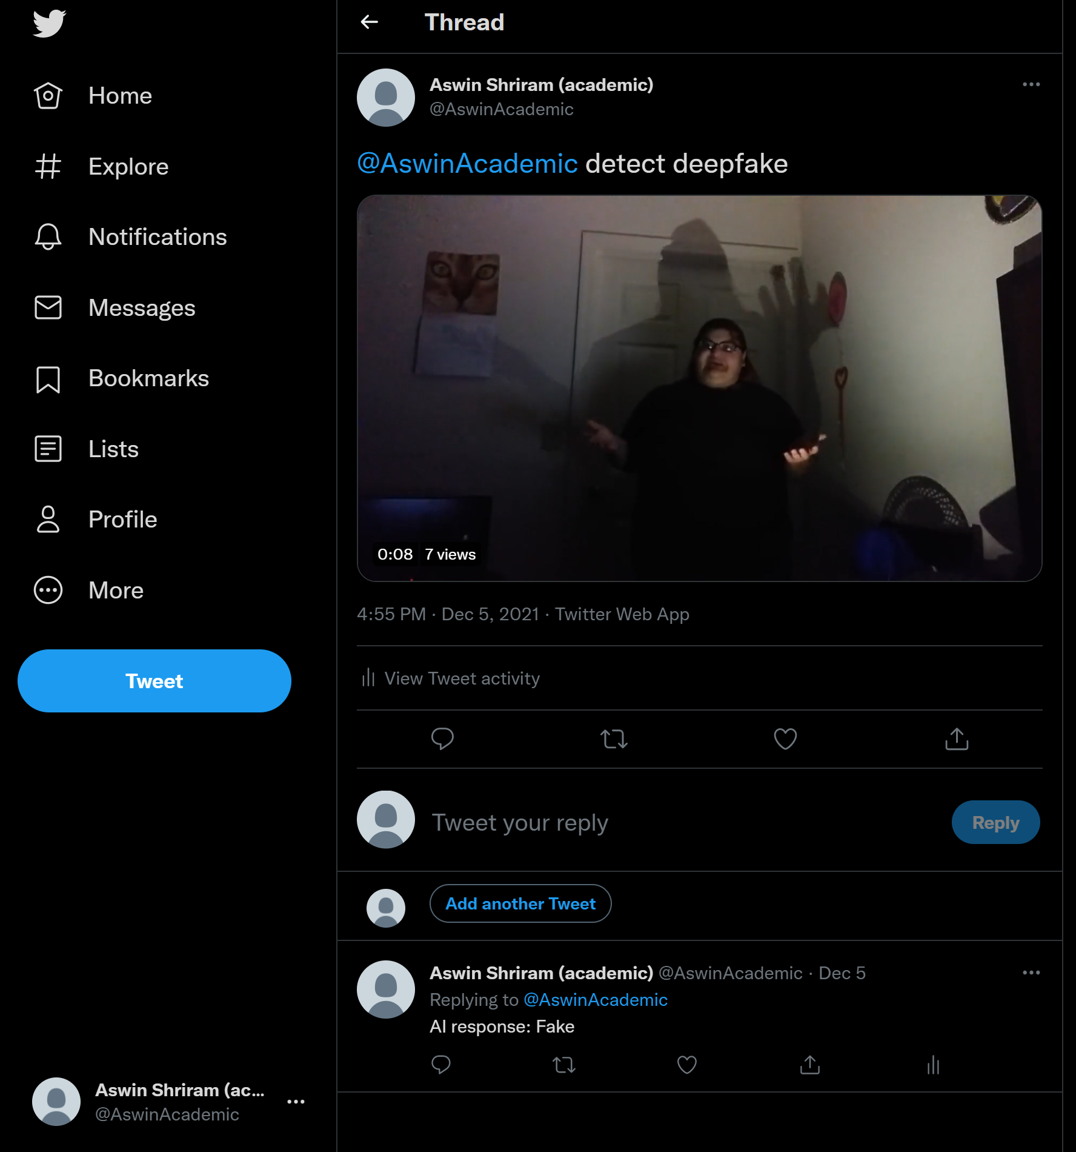
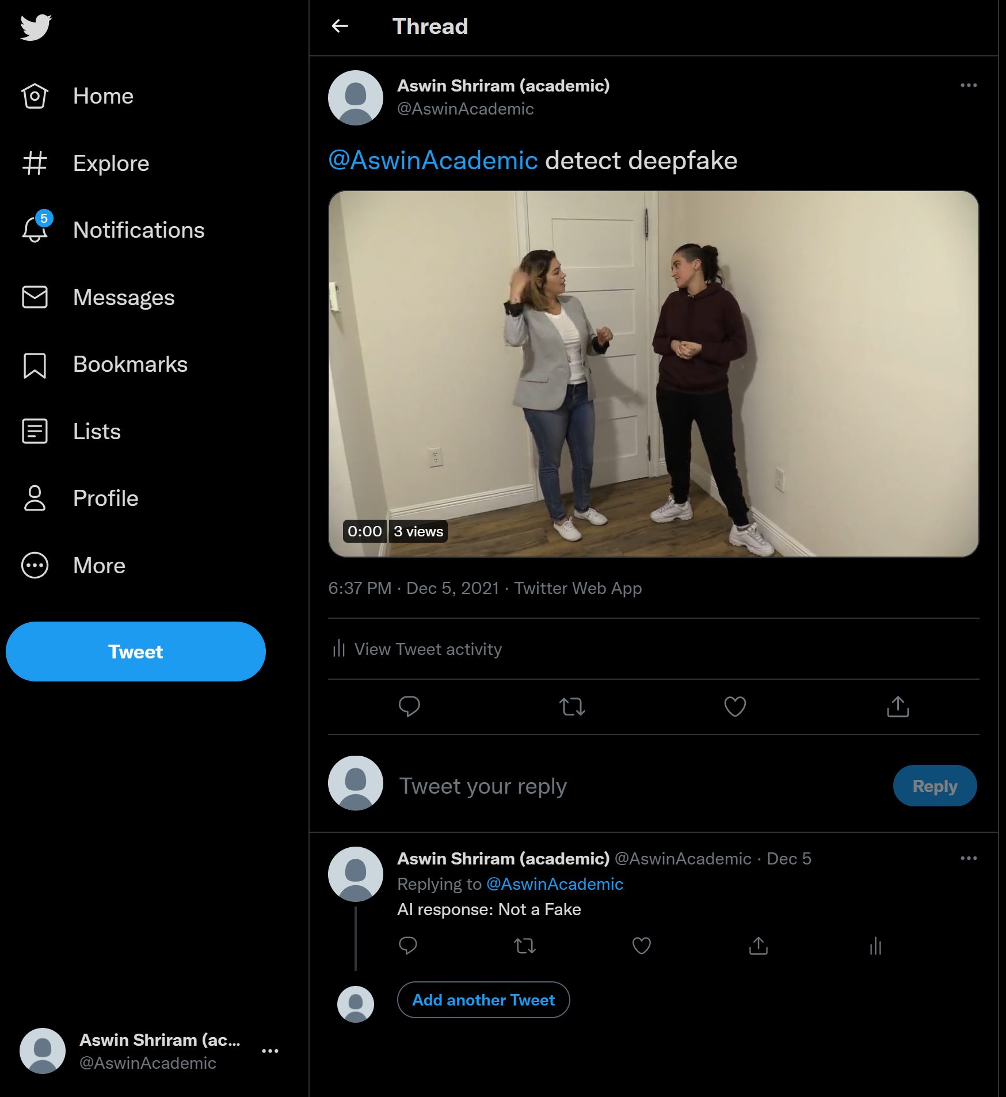
Actual Output

Slide 19
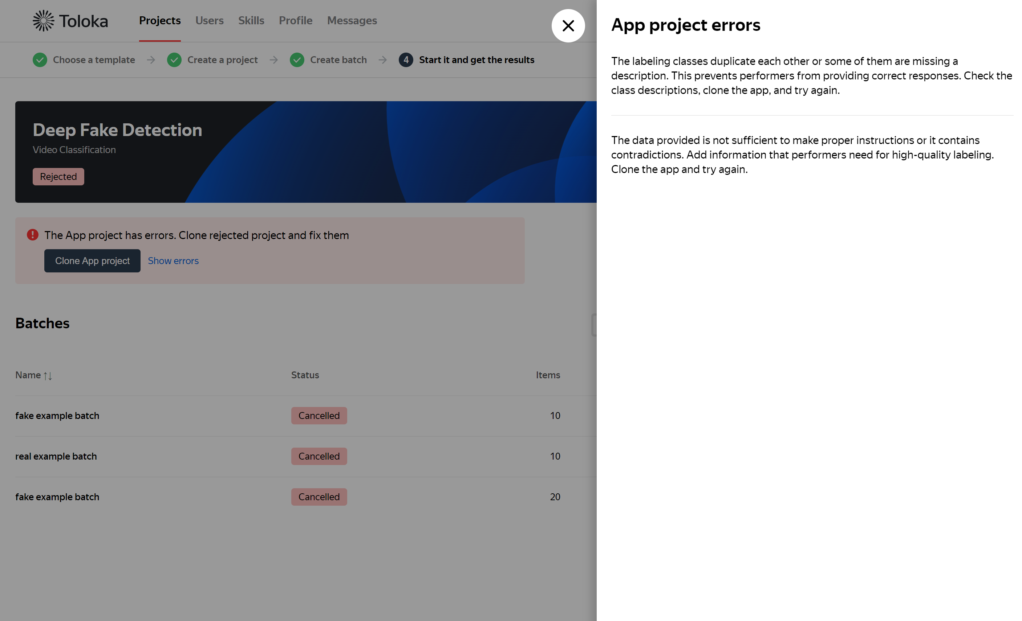
Actual Output

Slide 20
Challenges
This twitter bot is an open-source interface, but the crowd-sourcing system incurs cost to reward the human workers. Implementing a system with such hybrid model (economy wise) is practically a challenging problem
Building user trust on the AI outputs
However accurate the outputs are, still need not influence people’s beliefs
Can’t control behavior outside of Twitter platform
Wrongly tagging a video as fake can infuriate some

Slide 21
Technical Issues
The AI model cannot explain (yet) it’s decisions in a human interpretable way
Retraining the model to achieve better performance and generalization, is practically a hard and a continuous learning problem
Currently, any user can interact with the bot, and it might have to perform classification on the same data multiple times from different requests. This process is redundant and expensive (time and computational resource)
Difficulty in completing the overall pipeline
Can’t handle data types other than video
Crowd workers may not be able to correctly agree upon the result, as they may receive ambiguous inputs
Interfacing with the Toloka API is quite challenging and lot of process is involved from requesting OAUTH token, setting up a task pool, etc.

Slide 22
Application
Content filtering
Prevention of falsified information spread
Establishing ethical practices in social media platform (content regulation)
Encourage new research on context-based AI (including causality)
Revamping rules of social media

Slide 23
Future Work
Maintain database to store the results, which can be used for retrieving predictions for redundant data and also can be extended to search the social media platform and delete/watermark them as fake.
Explainability of the result from AI
Bot that can interact in Natural Language
Training the model using Reinforcement Learning as meta learning module with the feedback from the crowdsource workers as reward to the agent
Use automated digital forensic methods or symbolic AI like paradigm integration
Expand the data inputs to other data types like image, audio, text (news article)

Slide 24
References
Image links:
https://www.pngkit.com/png/full/182-1820449_whitepages-pro-machine-learning-machine-learning-model-icon.png
https://www.jing.fm/clipimg/detail/49-494451_metadata-extraction-data-analysis-icon.png
https://www.fotovalley.com/wp-content/uploads/2017/09/suitable-option-for-crowdsourcing-contest.jpg
Deepfake Model weights & code: selimsef/dfdc_deepfake_challenge: A prize winning solution for DFDC challenge (github.com)
Twitter Bot Code: Human_AI_Interaction/SimpleTwitterBot-main.zip at main · saiphcita/Human_AI_Interaction · GitHub

